Slide 1
AI DRIVEN INCOME TAX FRAUD DETECTION SYSTEM
PIP104 PROFESSIONAL PRACTICE-II
VIVA-VOCE
Batch Number:
Roll Number | Student Name
20201CBC0002 | Amulya C R
20201CBC0025 | Marhaba Eram
20201CBC0039 | Rashmi R
Under the Supervision of,
Dr. Srinivasan T R
Professor / Associate Professor / Assistant Professor
School of Computer Science Engineering & Information Science
Presidency University

Slide 2
Introduction
Artificial intelligence-driven income tax fraud detection systems are a rapidly expanding area of study and development. These systems have the potential to transform how tax authorities detect and prevent fraud.
AI-powered systems analyze massive volumes of data to spot trends and abnormalities that may signal fraud. This information may include tax returns financial activities and demographic data
The goal of this project is to create an AI-powered income tax fraud detection system utilizing machine learning methods. The system will be trained using a dataset of previous income tax returns, both legitimate and fraudulent. Once taught, the system will be able to accurately identify fresh fraudulent returns.

Slide 3
A range of machine learning algorithms including supervised learning, unsupervised learning and reinforcement learning will be used to build the system
Based on a collection of labeled data the system will be trained using supervised learning algorithms to identify fraudulent returns. Unsupervised learning algorithms will be used to detect patterns and abnormalities in data that could indicate fraud.
A range of programming languages and software tools will be used to implement the system. The system will be built to be scalable and efficient allowing it to process massive amounts of data in real time.

Slide 4
Literature review
A. Afzal The paper investigates the use of neural networks for detecting income tax fraud in Pakistan. The authors obtained a dataset of income tax returns from Pakistan's Federal Board of Revenue and trained several neural network architectures, including feedforward networks, convolutional networks, and LSTM networks, to determine whether or not tax returns were fraudulent.
N. M. Norwawi The paper presents a comparative study of supervised machine learning techniques for tax fraud detection. The authors utilize a dataset of personal income tax returns provided by the Inland Revenue Board of Malaysia. They train and evaluate multiple classification algorithms including logistic regression, random forests, SVM, Naive Bayes, and neural networks. The random forest classifier performs best with 95.7% accuracy in identifying fraudulent tax returns.
S. Afroz The paper investigates machine learning and data mining techniques for detecting tax fraud. The authors utilize a dataset of 50,000 income tax returns from the National Board of Revenue in Bangladesh. They extract and engineer relevant features from the raw tax data

Slide 5
K. Vanhoof The paper investigates unsupervised machine learning techniques for detecting tax fraud. The authors propose a Hybrid Unsupervised Outlier Detection (HUNOD) approach that combines several unsupervised outlier detection algorithms. They test HUNOD on a large dataset of personal income tax returns from Belgium.
M. Afzal The paper investigates using machine learning techniques for anomaly detection to identify tax fraud. The authors utilize a large dataset of individual tax returns from the Federal Board of Revenue in Pakistan. They train isolation forest local outlier factor and one-class SVM algorithms to detect anomalous tax returns that may indicate fraud. The isolation forest model performs best achieving high precision and recall above 99% on the test set

Slide 6
Research Gaps Identified
Notable gaps despite existing comprehensive literature.
Need for exploration in hybrid methods integrating supervised and unsupervised techniques - Aim to enhance adaptability to evolving fraud patterns for more accurate detection.
Interpretability and Explainability Aspects:
Lack of deep exploration in the research community.
Mention of HUNOD method's explainable surrogate models .
Call for a standardized framework for enhancing interpretability in tax fraud detection models.

Slide 7
Utilization of Taxpayer Network Data:
Emphasis on taxpayer network data by Baghdasaryan et al. (2022) - Promising avenue for improving fraud prediction accuracy .
Gap in understanding scalability and applicability across diverse tax systems and regions.
- Need for further research to assess the generalizability of network-based fraud detection models.

Slide 8
Proposed Methodology
Data Preprocessing:
Collect and clean dataset, addressing missing values, outliers, and ensuring consistency
Feature engineering to extract relevant information and create meaningful variables.
Standardize and normalize numerical features for uniformity in model training.
User Authentication and Data Input:
Implement a secure Streamlit login page for user access.
Differentiate between REGISTERED and UNREGISTERED users.
For REGISTERED users, prompt input of PAN numbers; for UNREGISTERED users, gather historical tax-related data

Slide 9
Exploratory Data Analysis (EDA):
Conduct thorough EDA to understand data distribution and characteristics. - Visualize data patterns, correlations, and potential outliers to inform feature selection.

Slide 10
Objectives
The data collection and preparation steps are essential for building an effective fraud detection model. The quality of the data will have a direct impact on the performance of the model.
It is important to use a variety of machine learning algorithms and to evaluate the performance of the model on a held-out test set before deploying it to production.
The model should be monitored and retrained as needed to ensure that it remains accurate and effective.
The feedback from the tax auditors is essential for improving the accuracy of the fraud detection model
Contribution to the technical evolution of tax compliance systems. Promotion of efficiency, accuracy, and
integrity in financial monitoring.

Slide 11
Emphasizes ongoing monitoring and refinement based on feedback.
Adapts to emerging fraud patterns and evolving tax scenarios.-
Contributes to the advancement of tax compliance systems.
Incorporates machine learning methodologies for improved efficiency and accuracy.

Slide 12
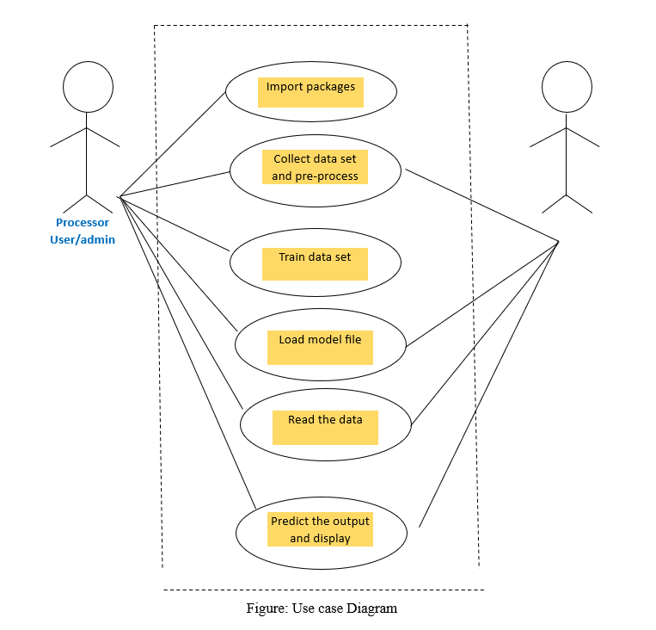
System Design & Implementation

Slide 13
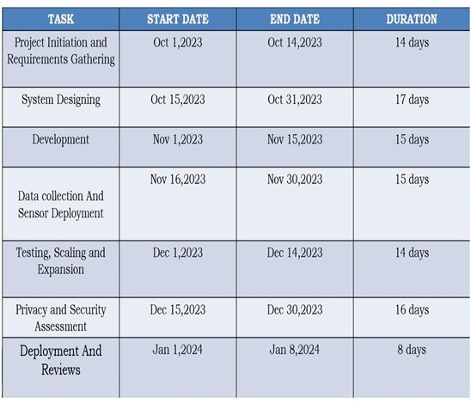
Timeline of Project

Slide 14
Outcomes / Results Obtained
Enhanced Tax Monitoring Capabilities:
- Improved ability to identify and predict tax fraud activities.
- Proactive toolset for tax authorities.
Dual Functionalities for Users:
- Streamlit-based interface catering to both REGISTERED and UNREGISTERED users.
- Utilizes PAN numbers for registered users.
- Machine Learning Algorithms for UNREGISTERED Users:
- Random Forest, Logistic Regression, and Gradient Boosting employed.
Machine Learning Algorithms for UNREGISTERED Users:
- Random Forest, Logistic Regression, and Gradient Boosting employed.
- Trained and evaluated using historical tax-related data (2012-2022).

Slide 15
Data Filtering and Visualization for REGISTERED Users:
- System employs techniques to discern potential fraud patterns.
- Emphasis on meticulous data exploration and visualization.
- Utilizes historical tax data to provide predictive insights into potential tax fraud activities.
Efficiency, Accuracy, and Integrity:
- Promotes efficiency, accuracy, and integrity in financial monitoring.
- Aims to instill trust in the tax compliance system's decision-making processes.

Slide 16
Conclusion
Existing literature covers machine learning applications in tax fraud detection.
Notable research gaps include the need for hybrid methods integrating supervised and unsupervised techniques for dynamic fraud detection
Further exploration into interpretability and explainability aspects of machine learning models in tax fraud detection is required.
The HUNOD method incorporates explainable surrogate models, but a standardized framework for interpretability is lacking
The use of taxpayer network data, as suggested by Baghdasaryan et al. (2022), is a promising avenue for improving fraud prediction accuracy
Research is needed to understand the scalability and applicability of network-based fraud detection models across diverse tax systems and regions.

Slide 17
References
.[1]“Fraud Detection Using Neural Networks: A Case Study of Income Tax" by A. Afzal, A. Iqbal, M. T. Tausif, and S. A. Khan (2022)”
[2].“Hybrid Unsupervised Outlier Detection (HUNOD) for Tax Fraud Detection" by K. Vanhoof, J. Verhulst, and M. Baesens (2021)”
[3].“Anomaly Detection for Tax Fraud Identification: A Machine Learning Approach" by M. Afzal, S. A. Khan, A. Iqbal, and M. T. Tausif (2021)”
[4].“Tax Fraud Detection Using Supervised Machine Learning: A Comparative Study" by N. M. Norwawi, M. A. Ismail, and A. K. Gani (2020)”

Slide 18
[5].“Tax Fraud Detection Using Machine Learning and Data Mining Techniques" by S. Afroz and G. M. Rahman (2019)”
[6].“Application of Machine Learning for Detecting Tax Evasion" by R. J. Hyndman, D. L. Brown, D. M. Hand, and L. A. Demsey (2012)”
[7].“Fraud Detection Using Data Mining Techniques" by V. Kouropoulos, D. Psarakis, and Y. Markos (2011)”
https://assets.kpmg/content/dam/kpmg/pdf/2016/07/using-analytics-sucessfully-to-detect-fraud.pdf
https://medium.com/analytics-vidhya/math-behind-artificial-neural-networks-42f260fc1b25
https://machinelearningmastery.com/difference-between-a-

Slide 19
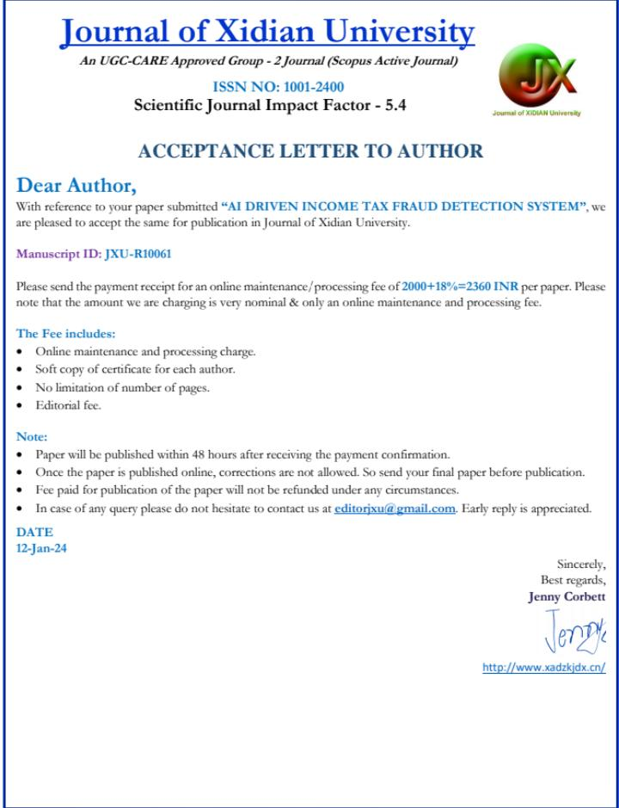
Publication Details

Slide 20

Thank You

